Slide 1
CPS 422 Computer Networks
Week 6
Dr Faisal Bashir
CPS422: Application

Slide 2
Domain Name System
CPS422: Application

Slide 3
Domain Name Servers
Domain name servers translate domain names to IP addresses. That sounds like a simple task, and it would be -- except for five things:
  There are billions of IP addresses currently in use, and most machines have a human-readable name as well.
  There are many billions of DNS requests made every day. A single person can easily make a hundred or more DNS requests a day, and there are hundreds of millions of people and machines using the Internet daily.
  Domain names and IP addresses change daily.
  New domain names get created daily.
  Millions of people do the work to change and add domain names and IP addresses every day.
The DNS system is a database, and no other database on the planet gets this many requests. No other database on the planet has millions of people changing it every day, either. That is what makes the DNS system so unique.

Slide 4
TLD
www.yahoo.com – a best-known name
www.mit.edu - a popular EDU name
www.bbc.co.uk - a name using four parts rather than three
ftp.microsoft.com - an FTP server rather than a Web server
The COM, EDU and UK portions of these domain names are called the top-level domain or first-level domain. There are several hundred top-level domain names, including COM, EDU, GOV, MIL, NET, ORG and INT, as well as unique two-letter combinations for every country.
Within every top-level domain there is a huge list of second-level domains. For example, in the COM first-level domain, you've got:
  howstuffworks , yahoo , msn , microsoft , plus millions of others...
Because all of the names in a given domain need to be unique, there has to be a single entity that controls the list and makes sure no duplicates arise.
  For example, the COM domain cannot contain any duplicate names, and a company called Network Solutions is in charge of maintaining this list.
Notes:
In the case of bbc.co.uk, it is a third-level domain. Up to 127 levels are possible, although more than four is rare.

Slide 5
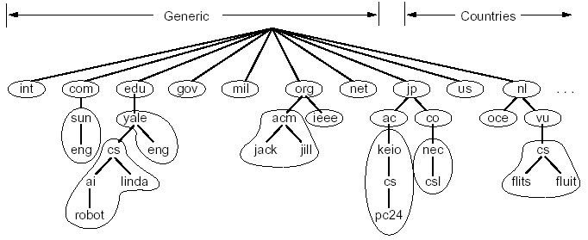
DNS: Domain Name System
Naming scheme
  a hierarchical naming space to avoid name conflict
called a zone
CPS422: Application

Slide 6
Authoritative Servers
It is important to have a central authority keeping track of the database of names in the COM (and other) top-level domain, you would not want to centralize the database of all of the information in the COM domain.
  For example, Microsoft has hundreds of thousands of IP addresses and host names. Microsoft wants to maintain its own domain name server for the microsoft.com domain
Every domain has a domain name server somewhere that handles its requests, and there is a person maintaining the records in that DNS.

Slide 7
Distributed Management of the Domain Name Space
A distributed database managed by authoritative name servers
  divided into zones, where each zone is a sub-tree of the global tree
  each zone has its own authoritative name servers
  an authoritative name server of a zone may delegate a subset (i.e. a sub-tree) of its zone to another name server
called a zone
CPS422: Application

Slide 8
DNS basic operation
Name servers do two things all day long:
  They accept requests from programs to convert domain names into IP addresses.
  They accept requests from other name servers to convert domain names into IP addresses.
When a request comes in, the name server can do one of four things with it:
  It can answer the request with an IP address because it already knows the IP address for the domain.
  It can contact another name server and try to find the IP address for the name requested. It may have to do this multiple times.
  It can say, "I don't know the IP address for the domain you requested, but here's the IP address for a name server that knows more than I do."
  It can return an error message because the requested domain name is invalid or does not exist.
When you set up your machine on the Internet, you had to tell your machine what name server it should use for converting domain names to IP addresses. On some systems, the DNS is dynamically fed to the machine when you connect to the ISP.

Slide 9
Root Name Servers
A name server would start its search for an IP address by contacting one of the root name servers. The root servers know the IP address for all of the name servers that handle the top-level domains.
Obviously, these root servers are vital to this whole process, so:
  There are many of them scattered all over the planet.
  Every name server has a list of all of the known root servers. It contacts the first root server in the list, and if that doesn't work it contacts the next one in the list, and so on.

Slide 10
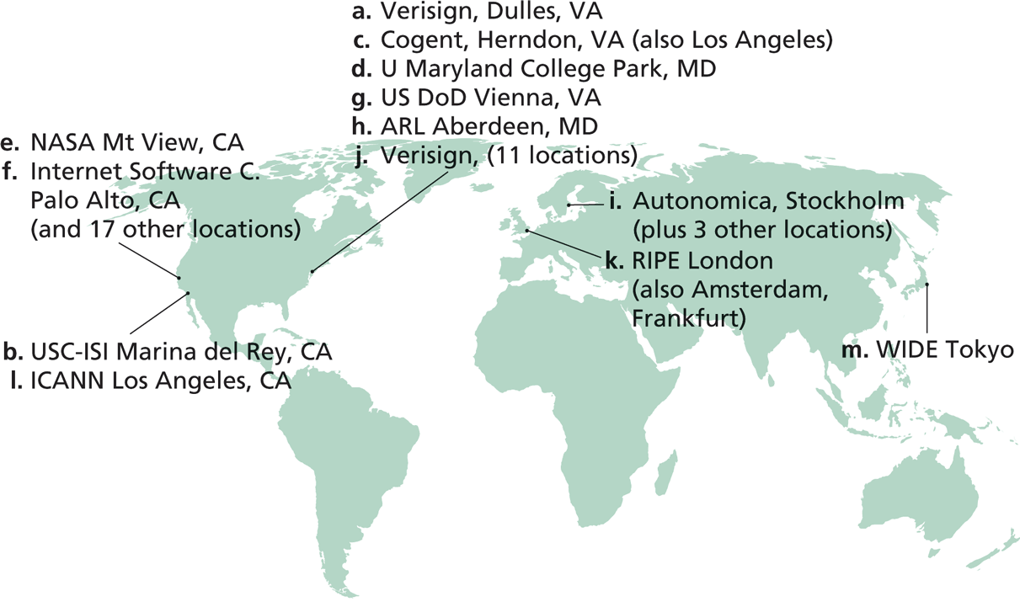
Root Zone and Root Servers
The root zone is managed by the root name servers
  13 root name servers worldwide (A-M)
See http://root-servers.org/ for more details
CPS422: Application

Slide 11
TLD and Authoritative Servers
Top-level domain (TLD) servers: responsible for com, org, net, edu, etc, and all top-level country domains uk, fr, ca, jp.
  Network solutions maintains servers for com TLD
  Educause for edu TLD
Authoritative DNS servers: organization’s DNS servers, providing authoritative hostname to IP mappings for organization’s servers (e.g., Web and mail).
  Can be maintained by organization or service provider
CPS422: Application

Slide 12
Local Name Server
Does not strictly belong to hierarchy
Each ISP (residential ISP, company, university) has one.
  Also called “default name server”
When a host makes a DNS query, query is sent to its local DNS server
  Acts as a proxy, forwards query into hierarchy.
Local DNS server is learned from DHCP, or configured
CPS422: Application

Slide 13
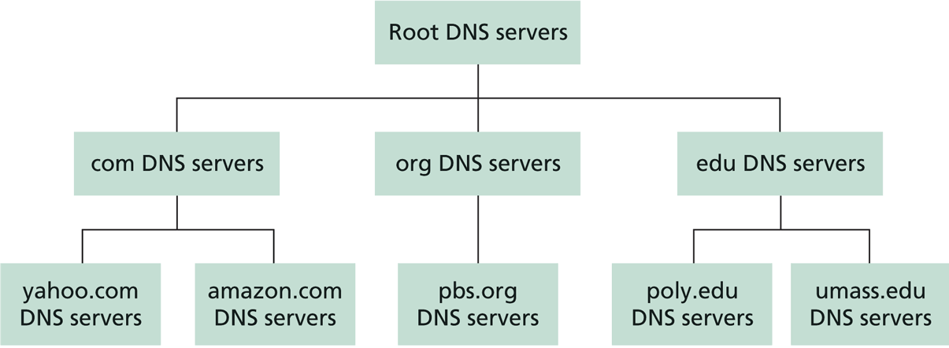
Linking the Name Servers
Each name server knows the addresses of the root servers
Each name server knows the addresses of its immediate children (i.e., those it delegates)
Top level domain
(TLD)
CPS422: Application

Slide 14
Example www.yahoo.com
The root server knows the IP addresses of the name servers handling the several hundred top-level domains. It returns to your name server the IP address for a name server for the COM domain.
Your name server then sends a query to the COM name server asking it if it knows the IP address for www.yahoo.com.
The name server for the COM domain knows the IP addresses for the name servers handling the www.yahoo.com domain, so it returns those.
Your name server then contacts the name server of yahoo and asks if it knows the IP address for www.yahoo.com.
It does, so it returns the IP address to your name server, which returns it to the browser, which can then contact the server for www.yahoo.com to get a Web page.

Slide 15
DNS Message Flow:
Two Types of Queries
Recursive query:
Puts burden of name resolution on contacted name server
  the contacted name server resolves the name completely
Iterated query:
Contacted server replies with name of server to contact
  “I don’t know this name, but ask this server”
CPS422: Application

Slide 16
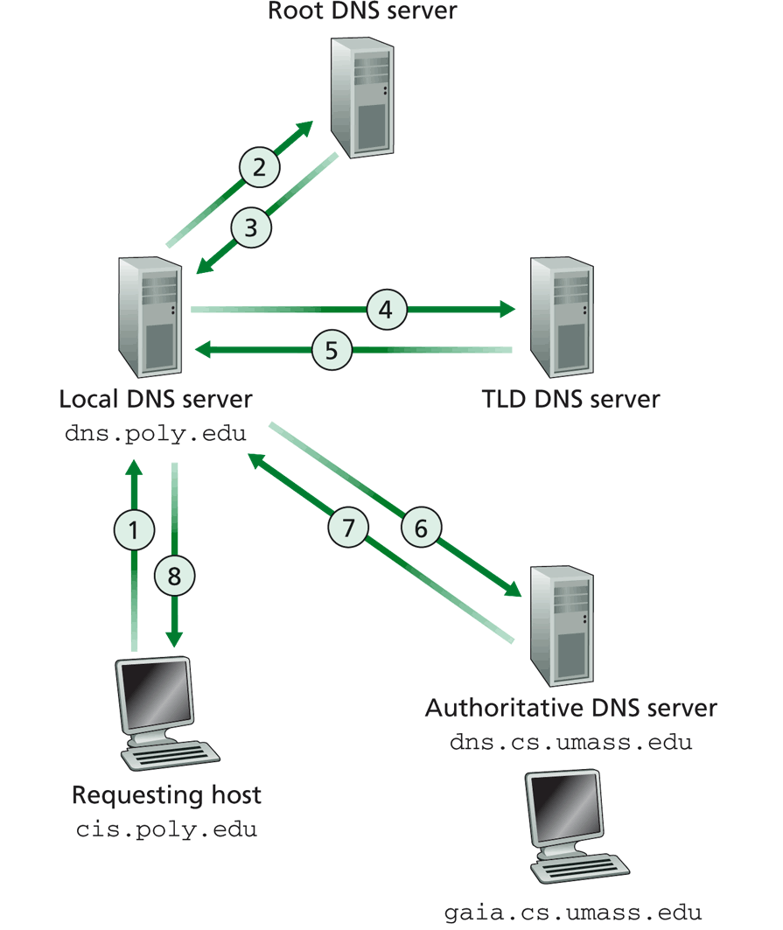
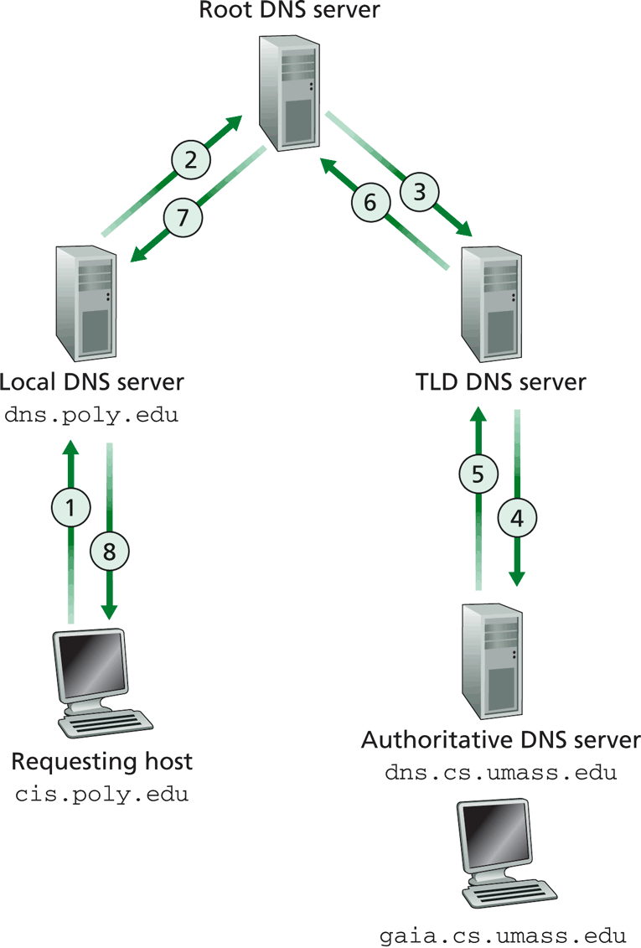
DNS Message Flow: Examples
CPS422: Application

Slide 17

DNS Message Flow: The Hybrid Case
root name server
2
iterated query
3
4
7
local name server
130.132.1.9
TLD name server
5
6
1
8
authoritative name server
dns.cs.umass.edu
requesting host
cyndra.cs.yale.edu
gaia.cs.umass.edu
CPS422: Application

Slide 18
DNS Important features
One of the keys to making this work is redundancy.
The other key is caching. (ranging from minutes to days)
  Once a name server has made a request to a root server for any COM domain, it knows the IP address for a name server handling the COM domain, so it doesn't have to bug the root servers again for that information.

Slide 19
DNS Resolution Example
Scenario and Assumptions
“XYZ Industries” runs its own DNS servers for the “xyzindustries.com” zone
The master name server is called “ns1.xyzindustries.com”, and the slave is “ns2.xyzindustries.com”
These are also used as local DNS servers for resolvers on client machines
Our DNS servers accept recursive requests from machines within our company, but will not assume other machines will accept such request
Both the server and resolver perform caching, and the caches are initially empty
CPS422: Application

Slide 20
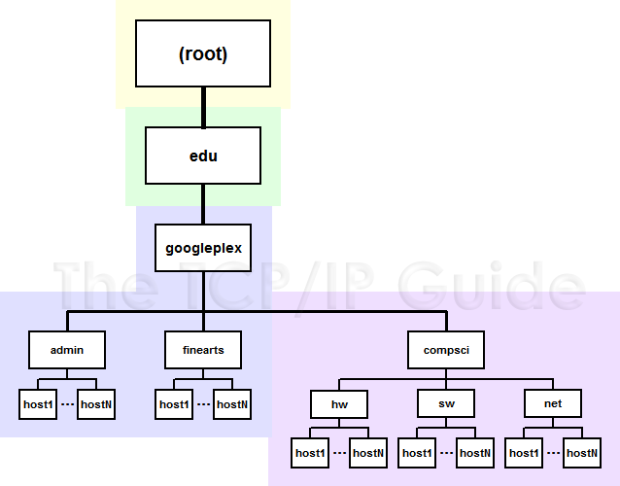
DNS Resolution Example
Googleplex University runs its own DNS servers for the “googleplex.edu” domain with the hierarchy as shown
An employee at XYZ types in the URL www.net.compsci.googleplex.edu
How will the DNS resolution for the host name take place?
www
CPS422: Application

Slide 21
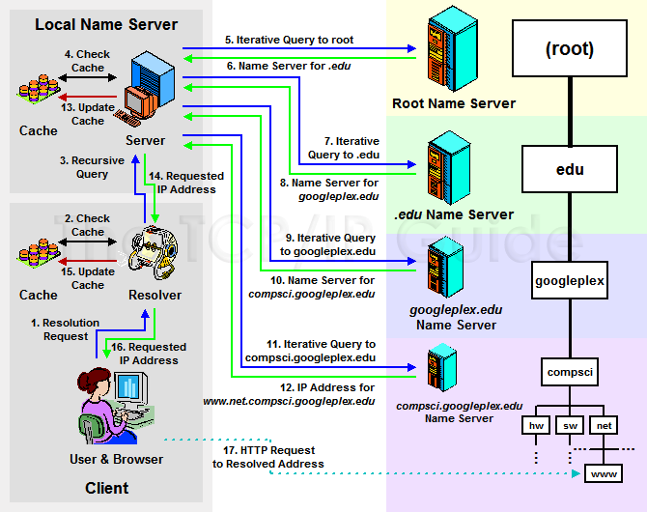
DNS Resolution Example
CPS422: Application

Slide 22
DNS records
DNS: distributed db storing resource records (RR)
RR format: (name, value, type, ttl)
Type=A
  name is hostname
  value is IP address
Type=CNAME
  name is alias name for some “cannonical” (the real) name
  www.ibm.com is really
  servereast.backup2.ibm.com
  value is cannonical name
Type=NS
  name is domain (e.g. foo.com)
  value is the hostname of authoritative name server for this domain
Type=MX
  value is name of mailserver associated with name
CPS422: Application

Slide 23
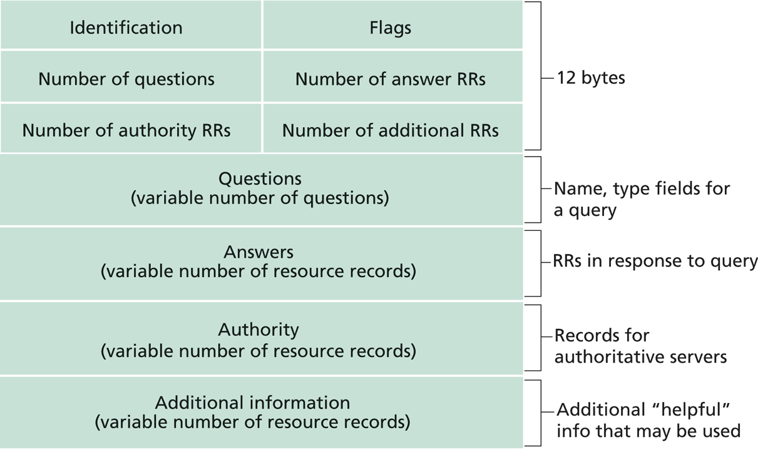
DNS Protocol, Messages
DNS protocol : over UDP/TCP; query and reply messages, both with the same message format
DNS Msg header:
identification: 16 bit # for query, the reply to a query uses the same #
flags:
  query or reply
  recursion desired
  recursion available
  reply is authoritative
CPS422: Application

Slide 24
Inserting records into DNS
example: new startup “Network gaint”
register name networkgaint.com at DNS registrar(e.g., Network Solutions)
provide registrar with the names, IP addresses of your authoritative name server (primary and secondary)
registrar inserts two RRs into com TLD server:
    (networkgaint.com, dns1.networgaint.com, NS)
    (dns1.networkgaint.com, 212.212.212.1, A)
create your own authoritative server Type A record for www.networkgaint.com; Type MX record for networkgaint.com
How do people get IP address of your Web site?
CPS422: Application

